Slide 1
Ashish Goyal and John M. Murray
How to optimize budget allocation among interventions modulating the hepatitis B and hepatitis D epidemics in China?

Slide 2
Hepatitis B and hepatitis D virus- Why study together?

Slide 3
Why China?

Slide 4


Transmission routes and preventive measures
Vertical transmission – Mother to Child during birth (Only HBV)
Can be prevented using HBV newborn vaccination
Horizontal transmission - Sexually transmitted
Can be prevented with HBV adult vaccination or use of condoms
Any other form of blood contact such as among injecting drug users.
Can be prevented by providing them safe syringes
What about already infected individuals?
Providing them treatment so that they can recover

Slide 5
Literature Background
Xiridou et al. : First one to capture HBV and HDV transmission dynamics in a population. But only focused on horizontal transmission.
Later on, expanded by Goyal A. and Murray JM which included vertical transmission as well.
Recent study by Goyal A. and Murray JM showed that if the objective is to minimize the cost, then treating HDV infected individuals is not optimal (but is it ethical?).
HDV can modulate HBV prevalence as well as interventions modulating HBV prevalence.
References:
Xiridou et al, How hepatitis D virus can hinder the control of hepatitis B virus, PloS ONE, 2009.
Goyal A. and Murray JM, The Impact of Vaccination and Antiviral Therapy on Hepatitis B and Hepatitis D Epidemiology, PloS ONE, 2014.
Goyal A. and Murray JM, Recognizing the impact of endemic hepatitis D virus on hepatitis B virus eradication, Theoretical Population Biology (Under review).

Slide 6
Schematic representation of HBV and HDV epidemiology

Slide 7
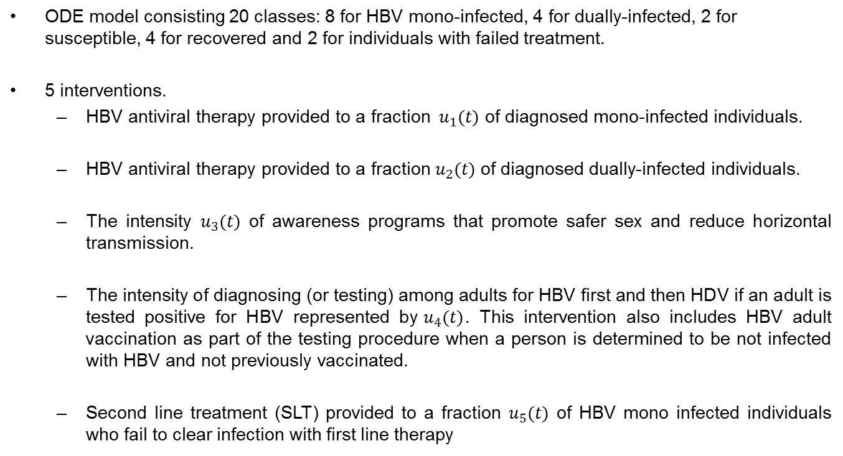
Mathematical model
ODE model consisting 20 classes: 8 for HBV mono-infected, 4 for dually-infected, 2 for susceptible, 4 for recovered and 2 for individuals with failed treatment.
5 interventions.
  HBV antiviral therapy provided to a fraction ${ u}_{1}(t)$ of diagnosed mono-infected individuals.
  HBV antiviral therapy provided to a fraction $u_{2}(t)$ of diagnosed dually-infected individuals.
  The intensity $u_{3}(t)$ of awareness programs that promote safer sex and reduce horizontal transmission.
  The intensity of diagnosing (or testing) among adults for HBV first and then HDV if an adult is tested positive for HBV represented by${ u}_{4}(t)$. This intervention also includes HBV adult vaccination as part of the testing procedure when a person is determined to be not infected with HBV and not previously vaccinated.
  Second line treatment (SLT) provided to a fraction $u_{5}(t)$ of HBV mono infected individuals who fail to clear infection with first line therapy

Slide 8
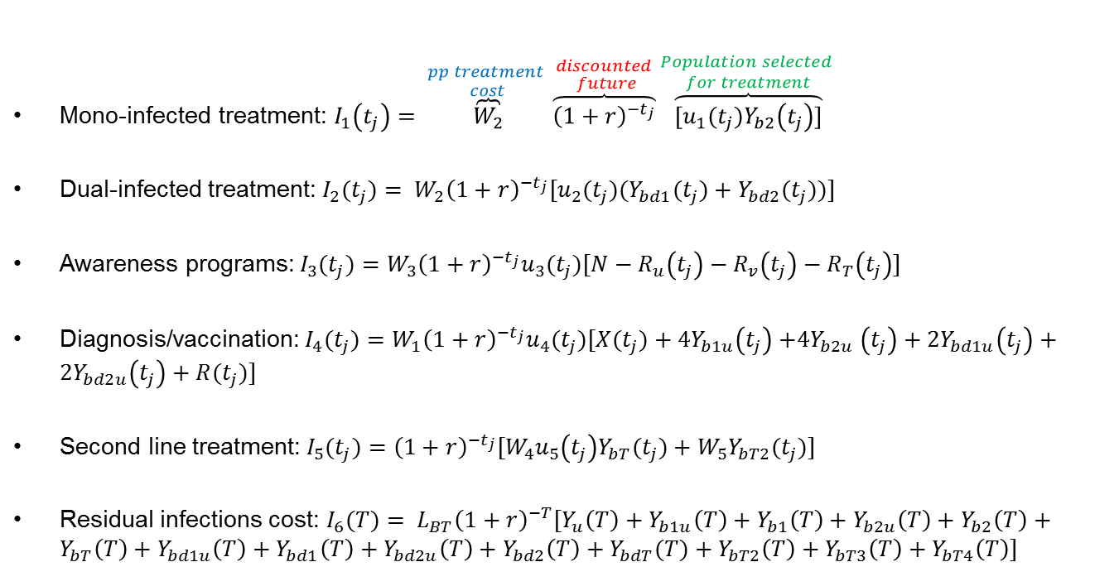
Cost of individual interventions
Mono-infected treatment: $I_{1}\left(t_{j}\right)= \overset{\begin{aligned}pp treatment \\ cost\end{aligned}}{\overbrace{W_{2}}}\overset{\begin{aligned}discounted \\ future\end{aligned}}{\overbrace{{\left(1+r\right)}^{−t_{j}}}}\overset{\begin{aligned}Population selected \\ for treatment\end{aligned}}{\overbrace{[u_{1}(t_{j})Y_{b2}\left(t_{j}\right)]}}$
Dual-infected treatment:$I_{2}(t_{j})= W_{2}{{\left(1+r\right)}^{−t_{j}}[u}_{2}(t_{j})(Y_{bd1}(t_{j})+Y_{bd2}(t_{j}))]$
Awareness programs: $I_{3}(t_{j})=W_{3}{{\left(1+r\right)}^{−t_{j}}u}_{3}(t_{j})[N−R_{u}\left(t_{j}\right)−R_{v}\left(t_{j}\right)−R_{T}\left(t_{j}\right)]$
Diagnosis/vaccination:${ I}_{4}(t_{j})=W_{1}{\left(1+r\right)}^{−t_{j}}u_{4}(t_{j})[X(t_{j})+4Y_{b1u}\left(t_{j}\right){+4Y}_{b2u}\left(t_{j}\right)+2Y_{bd1u}\left(t_{j}\right)+{2Y}_{bd2u}\left(t_{j}\right)+R(t_{j})]$
Second line treatment:${ I}_{5}(t_{j})={\left(1+r\right)}^{−t_{j}}[W_{4}u_{5}\left(t_{j}\right)Y_{bT}(t_{j})+W_{5}Y_{bT2}(t_{j})]$
Residual infections cost: $I_{6}(T)= L_{BT}{\left(1+r\right)}^{−T}[{Y_{u}\left(T\right)+Y}_{b1u}\left(T\right)+Y_{b1}\left(T\right)+Y_{b2u}\left(T\right)+Y_{b2}\left(T\right)+Y_{bT}\left(T\right)+Y_{bd1u}\left(T\right)+Y_{bd1}\left(T\right)+Y_{bd2u}\left(T\right)+Y_{bd2}\left(T\right)+Y_{bdT}(T)+Y_{bT2}\left(T\right)+Y_{bT3}\left(T\right)+Y_{bT4}\left(T\right)]$

Slide 9
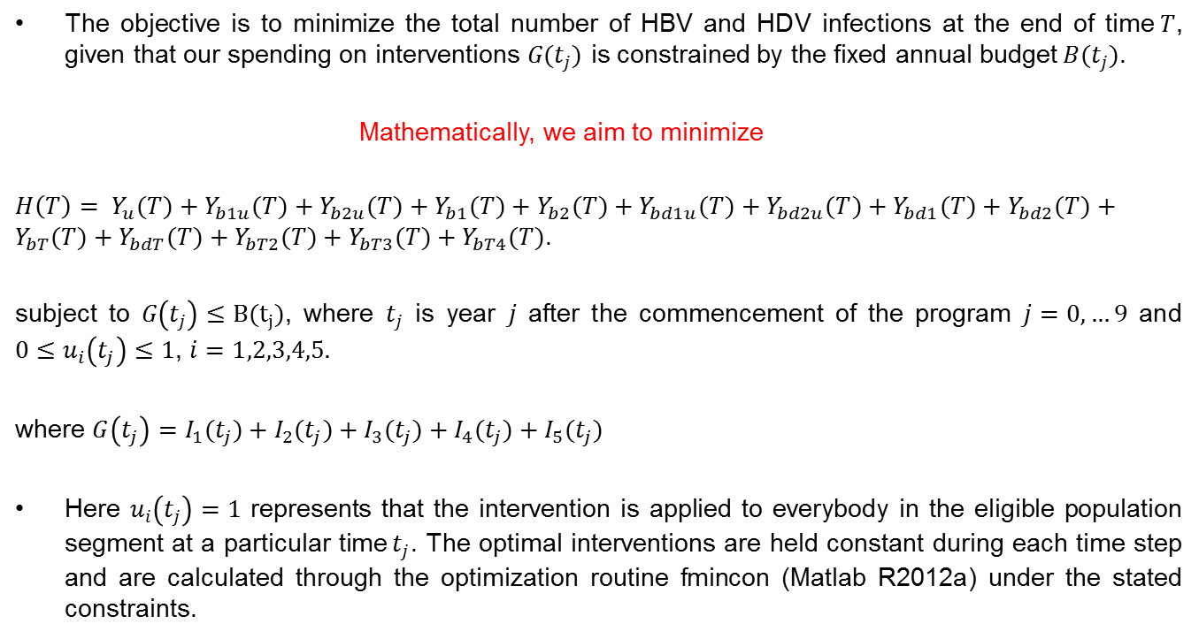
Procedure
The objective is to minimize the total number of HBV and HDV infections at the end of time$T$, given that our spending on interventions $G(t_{j})$ is constrained by the fixed annual budget$B(t_{j})$.
Mathematically, we aim to minimize
${H\left(T\right)= Y}_{u}(T)+Y_{b1u}(T)+Y_{b2u}(T)+Y_{b1}(T)+Y_{b2}(T)+Y_{bd1u}(T)+Y_{bd2u}(T)+Y_{bd1}(T)+Y_{bd2}(T)+Y_{bT}(T)+Y_{bdT}(T)+Y_{bT2}(T)+Y_{bT3}(T)+Y_{bT4}(T)$.
subject to $G\left(t_{j}\right)≤B(t_{j})$, where $t_{j}$ is year $j$ after the commencement of the program $j=0,…9$ and $0≤u_{i}\left(t_{j}\right)≤1$, $i=1,2,3,4,5.$
where $G\left(t_{j}\right)=I_{1}(t_{j})+I_{2}(t_{j})+I_{3}(t_{j})+I_{4}(t_{j})+I_{5}(t_{j})$
Here $u_{i}\left(t_{j}\right)=1$ represents that the intervention is applied to everybody in the eligible population segment at a particular time$t_{j}$. The optimal interventions are held constant during each time step and are calculated through the optimization routine fmincon (Matlab R2012a) under the stated constraints.

Slide 10
Year-wise optimal allocation of resources over the next 10 years among the four interventions.

Slide 11
Optimal allocation of resources among the four interventions over the next 10 years with an upper limit (2%) on testing.

Slide 12
Optimal allocation of resources over the next 10 years among five interventions including second line treatment for HBV mono-infected individuals who fail first line treatment.

Slide 13
Results associated with different scenarios applied to control endemic HBV and HDV in China.
Table 1: The total cost represents the sum of the cost of all interventions over the next 10 years plus the cost of residual infections at 2025.
 | No intervention | Four Interventions | Four Interventions with an upper limit | Five interventions with an upper limit
(%) HBV prevalence in 2025 | 5.23 | 2.62 | 3.63
(%) HDV prevalence in 2025 | 0.81 | 0.49 | 0.61 | 0.61
(%) Recovered Population by 2025 | 18.8 | 51.6 | 23.2 | 23.2
Death toll till 2025 (millions) | 1.91 | 1.44 | 1.66 | 1.66
Cost of interventions (billions) | Not Applicable | $61 | $43
Total cost (billions) | $674 | $375 | $485
3.62
$44
$485

Slide 14
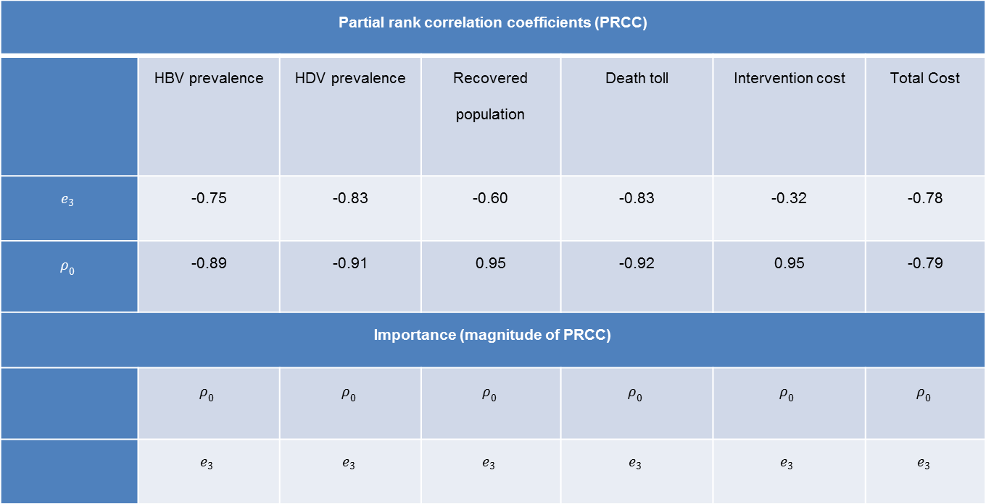

Sensitivity analysis of the parameters representing the efficacy of awareness programs $e_{3}$ and the upper limit of testing $ρ_{0}$ on outcomes at year 2025
Partial rank correlation coefficients (PRCC)
 | HBV prevalence | HDV prevalence | Recovered population | Death toll | Intervention cost | Total Cost
$$e_{3}$$ | -0.75 | -0.83 | -0.60 | -0.83 | -0.32 | -0.78
$$ρ_{0}$$ | -0.89 | -0.91 | 0.95 | -0.92 | 0.95 | -0.79
Importance (magnitude of PRCC)
 | $$ρ_{0}$$ | $$ρ_{0}$$ | $$ρ_{0}$$ | $$ρ_{0}$$ | $$ρ_{0}$$ | $$ρ_{0}$$
 | $$e_{3}$$ | $$e_{3}$$ | $$e_{3}$$ | $$e_{3}$$ | $$e_{3}$$ | $$e_{3}$$

Slide 15
Conclusion
Don’t forget HDV prevalence in the population.
Treatment of HDV infections is equally important to control HBV endemic (It is not currently not included in the treatment guidelines by China).
Lack of diagnosis conveys a significantly weaker control.
An additional 20.8 million HBV, 2.6 million HDV infections and 0.25 million lives can be saved over the next 10 years at a cost $189 billion lower than performing no intervention.
Introduction of second line treatment does not add a significant economic burden yet prevents 130,000 new HBV infections and 15,000 disease-related deaths.
Future Work : Heterogeneous mixing and high risk groups inclusion in the models.

Slide 16


