Slide 1


JMM Special Session
October 14-15, 2011 13th
Midwest Optimization Meeting & Workshop
on Large Scale Optimization and Applications
Hosted by the Fields Institute
http://www.fields.utoronto.ca/programs/scientific/11-12/optimization_mtg/
Friday October 14, 2011, 9:00 a.m. EDT (12.00pm AEST)

Slide 2

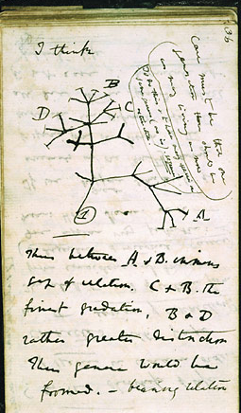

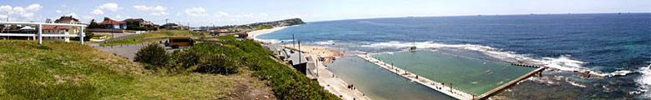


Midwest Optimization Meeting
& Workshop on
Large Scale Optimization and Applications
October 14th 2011
Douglas-Ratchford iterations in the absence of convexity
Charles Darwin’s notes
Alan Turing’s Enigma
Jonathan Borwein FRSC FAA FAAS www.carma.newcastle.edu.au/~jb616
Laureate Professor University of Newcastle, NSW
Director, Centre for Computer Assisted Research Mathematics and Applications CARMA
Revised 16-10-2011: joint work with B. Sims.
Thanks also to Ulli Kortenkamp, Fran Aragon, Matt Skerritt and Chris Maitland

Slide 3
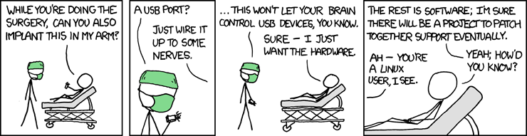
THE REST IS SOFTWARE
“It was my luck (perhaps my bad luck) to be the world chess champion during the critical years in which computers challenged, then surpassed, human chess players. Before 1994 and after 2004 these duels held little interest.” - Garry Kasparov, 2010
Likewise much of current Optimization Theory
Notes:
Update open questions

Slide 4
ABSTRACT
The Douglas-Rachford iteration scheme, introduced half a century ago in connection with nonlinear heat flow problems, aims to find a point common to two or more closed constraint sets.
  Convergence is ensured when the sets are convex subsets of a Hilbert space, however, despite the absence of satisfactory theoretical justification, the scheme has been routinely used to successfully solve a diversity of practical optimization or feasibility problems in which one or more of the constraints involved is non-convex.
As a first step toward addressing this deficiency, we provide convergence results for a proto-typical non-convex (phase-recovery) scenario: Finding a point in the intersection of the Euclidean sphere and an affine subspace.

Slide 5
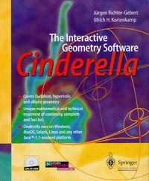
AN INTERACTIVE PRESENTATION
Much of my lecture will be interactive using the interactive geometry package Cinderella and the html applets
  www.carma.newcastle.edu.au/~jb616/reflection.html
  www.carma.newcastle.edu.au/~jb616/expansion.html
  www.carma.newcastle.edu.au/~jb616/lm-june.html

Slide 6
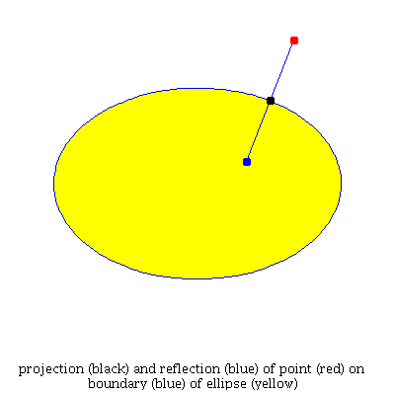
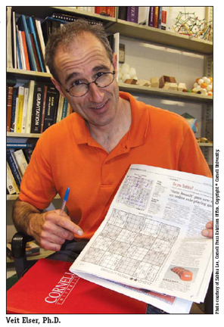
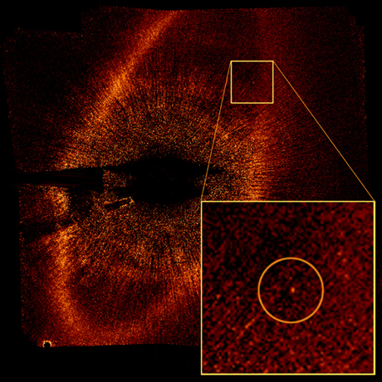
PHASE RECONSTRUCTION
Projectors and Reflectors: P_{A}(x) is the metric projection or nearest point and R_{A}(x) reflects in the tangent: x is red
x
A
A
P_{A}(x)
2008 Finding exoplanet Fomalhaut in Piscis with projectors
R_{A}(x)
"All physicists and a good many quite respectable mathematicians are contemptuous about proof." G. H. Hardy (1877-1947)
2007 Elser solving Sudoku with reflectors

Slide 7
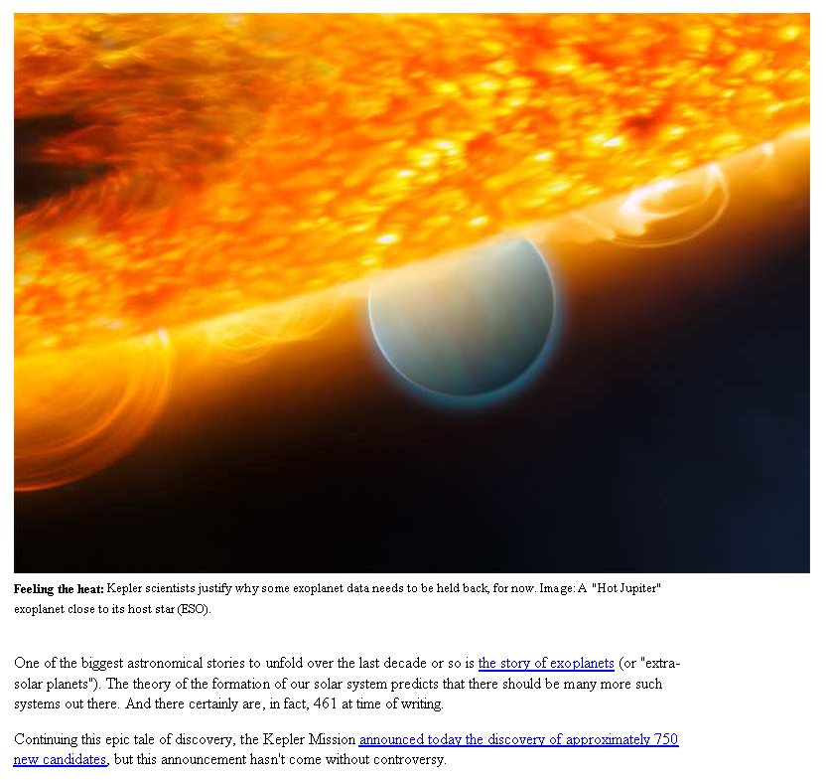
The story of Hubble’s 1.3mm error in the “upside down” lens (1990)
And Kepler’s hunt for exo-planets (launched March 2009)

Slide 8
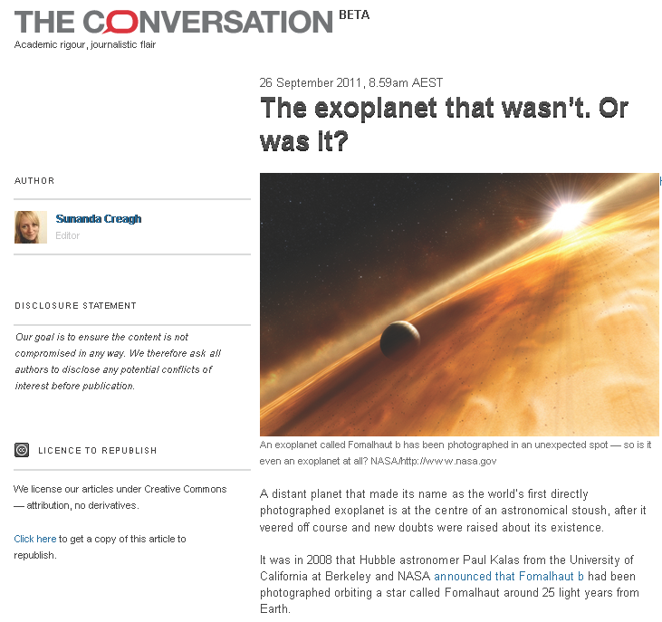
The story of Hubble’s 1.3mm error in the “upside down” lens (1990)
And Kepler’s hunt for exo-planets (launched March 2009)
A few weeks ago we wrote:
“We should add, however, that many Kepler sightings in particular remain to be ‘confirmed.’ Thus one might legitimately wonder how mathematically robust are the underlying determinations of velocity, imaging, transiting, timing, micro-lensing, etc.?
http://experimentalmath.info/blog/2011/09/where-is-everybody/

Slide 9
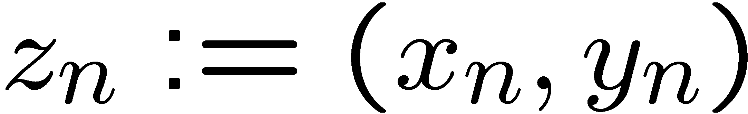
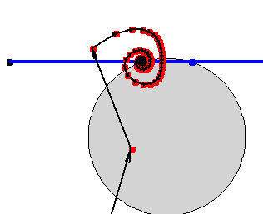
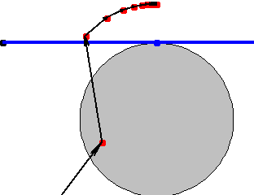
WHY DOES IT WORK?
In a wide variety of large hard problems (protein folding, 3SAT, Sudoku) A is non-convex but DR and “divide and concur” (below) works better than theory can explain. It is:
Consider the simplest case of a line B of height h and the unit circle A. With the iteration becomes
For h=0 We prove convergence to one of the two points in A Å B iff we do not start on the vertical axis (where we have chaos). For h>1 (infeasible) it is easy to see the iterates go to infinity (vertically). For h=1 we converge to an infeasible point. For h in (0,1) the pictures are lovely but proofs escaped us for 9 months. Two representative Maple pictures follow:
An ideal problem for introducing early under-graduates to research, with many many accessible extensions in 2 or 3 dimensions

Slide 10
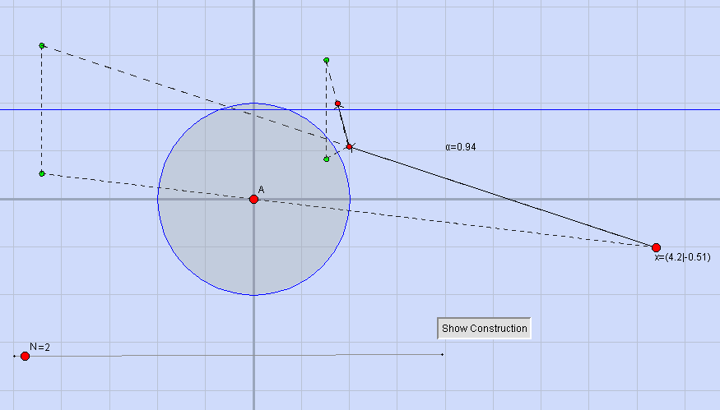
INTERACTIVE PHASE RECOVERY in CINDERELLA
Recall the simplest case of a line B of height h and the unit circle A. With the iteration becomes
A Cinderella picture of two steps from (4.2,-0.51) follows:
Notes:
The link is to reflection.html

Slide 11
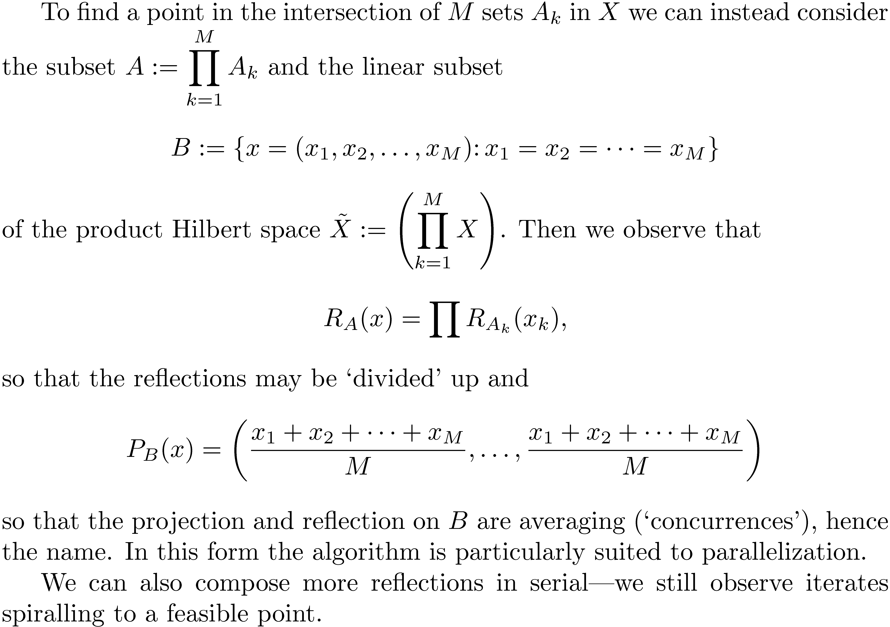
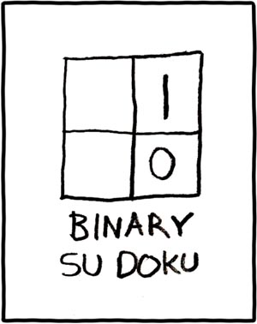
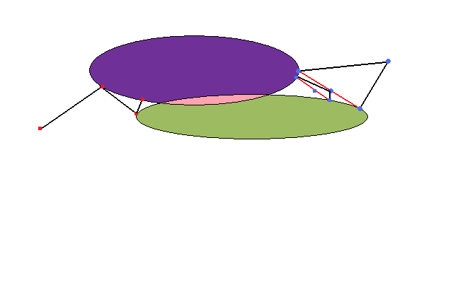
DIVIDE AND CONCUR
Serial (L) and Parallel (R)

Slide 12
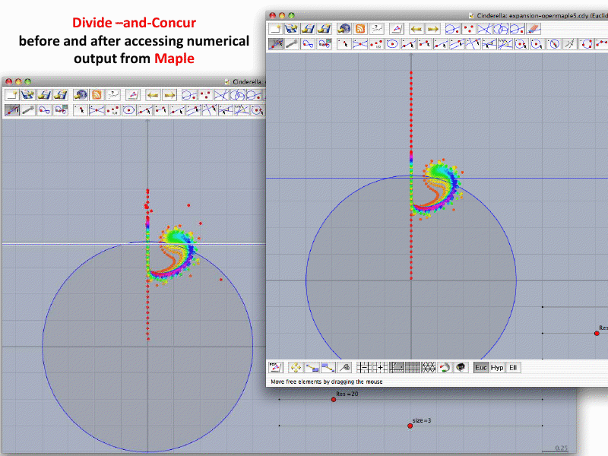
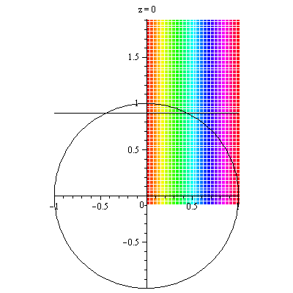
CAS+IGP: THE GRIEF IS IN THE GUI
Accuracy after taking input from Maple
Numerical errors in using double precision
Notes:
Link is expansion.cdy

Slide 13
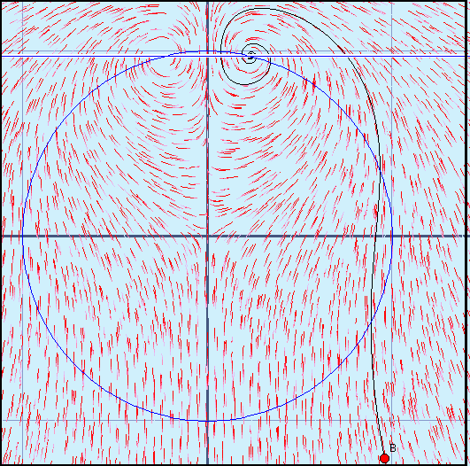
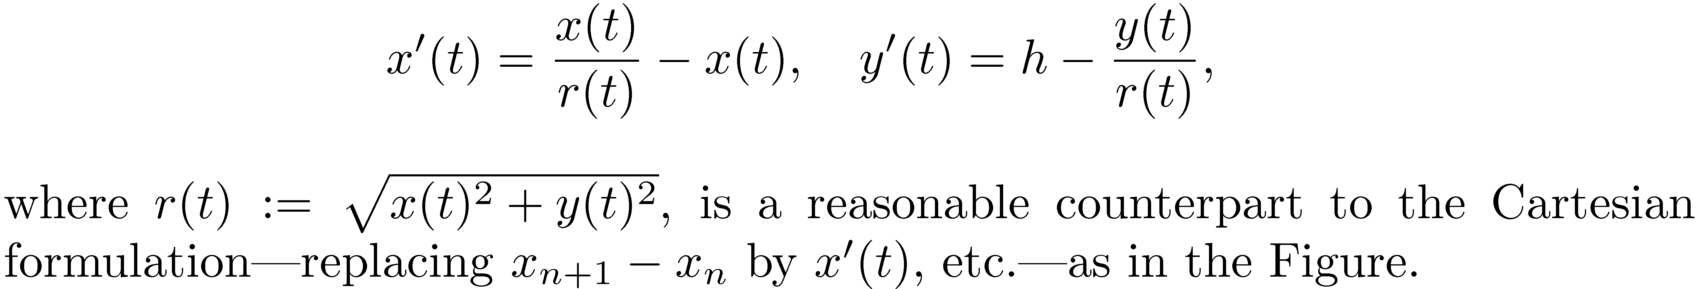

THE ROUTE TO DISCOVERY
Exploration first in Maple and then in Cinderella (SAGE)
  - ability to look at orbits/iterations dynamically is great for insight
  allows for rapid reinforcement and elaboration of intuition
Decided to look at ODE analogues
  - and their linearizations
  hoped for Lyapunov like results
Searched literature for a discrete version
  - found Perron’s work

Slide 14
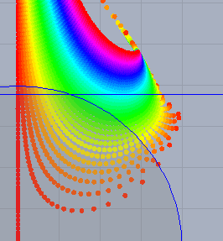
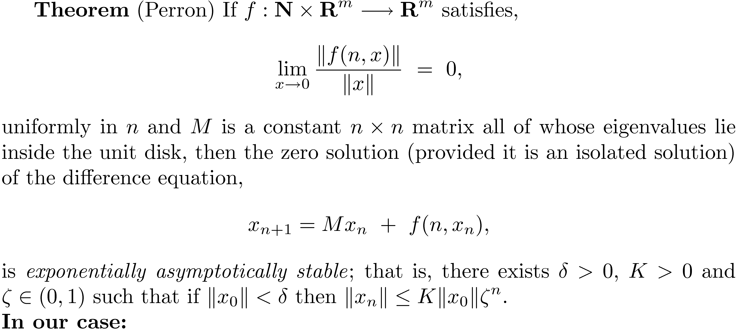
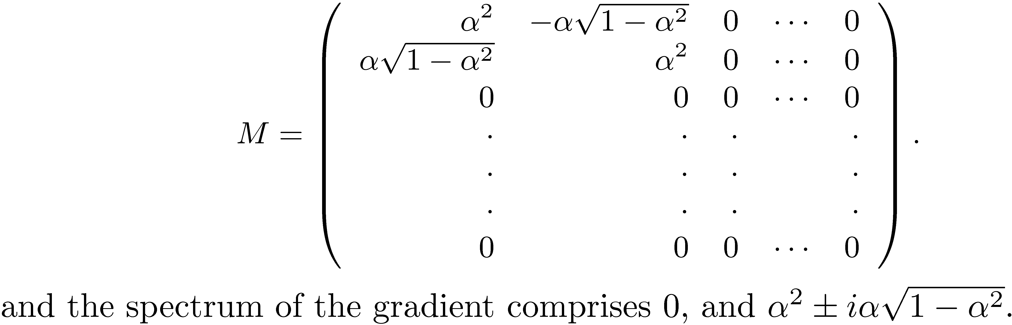
THE BASIS OF THE PROOF
Explains spin for height in (0,1)

Slide 15
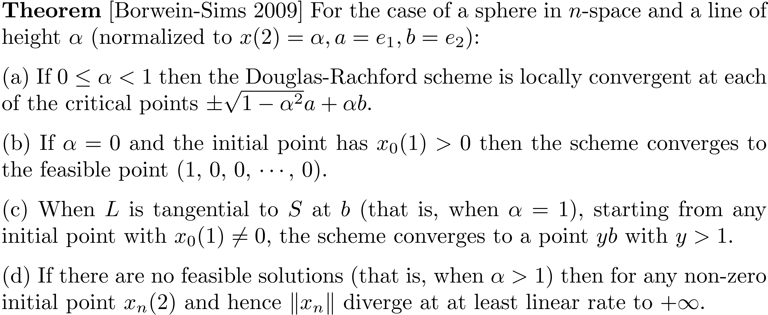
WHAT WE CAN NOW SHOW

Slide 16
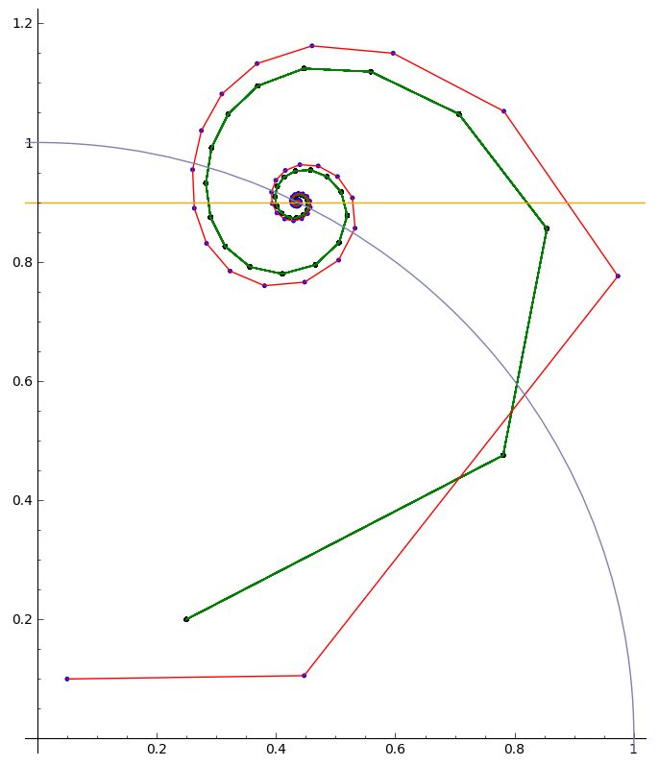
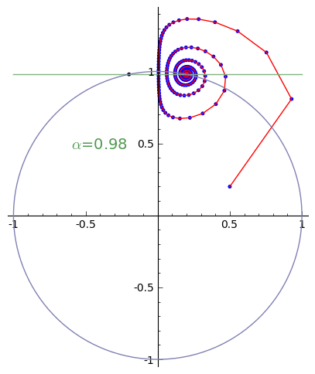
ALGORITHM APPEARS TO BE STABLE

Slide 17
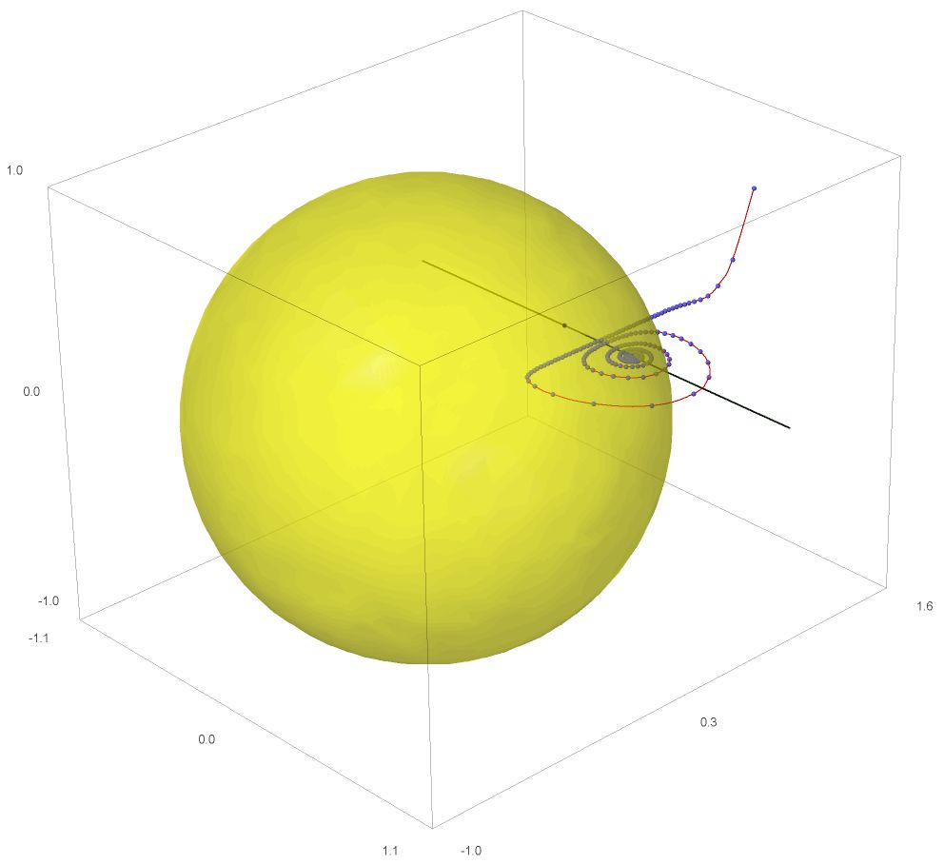
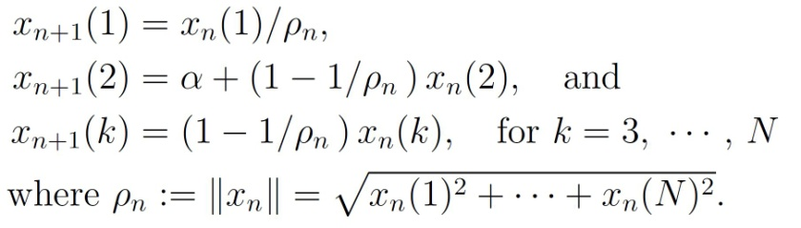
THREE AND HIGHER DIMENSIONS

Slide 18
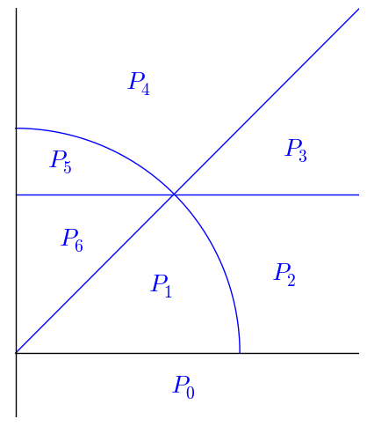
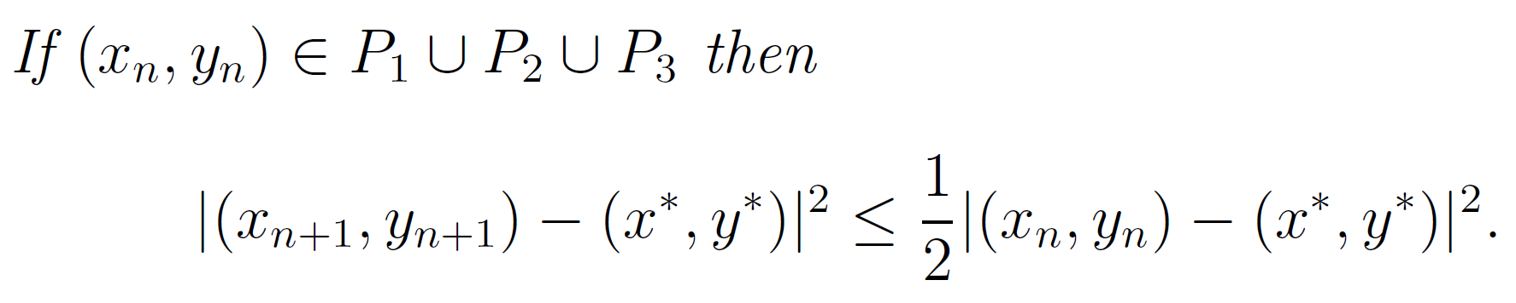
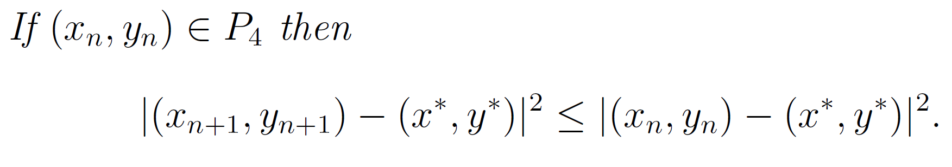
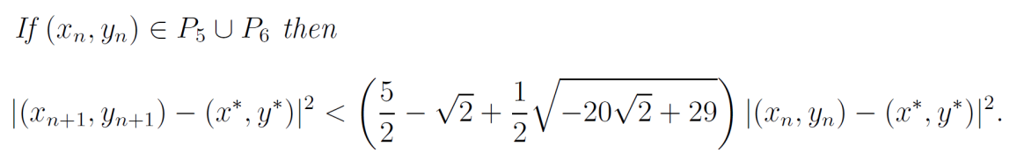
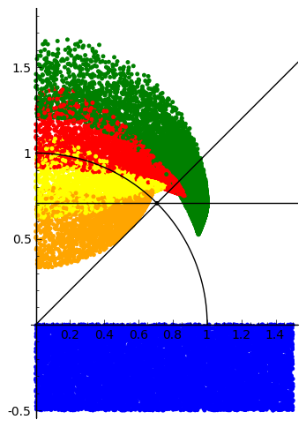
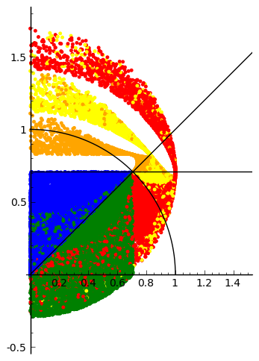
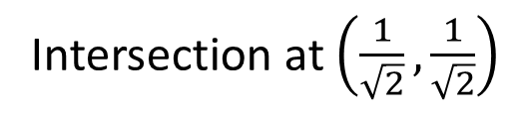
AN “EVEN SIMPLER” CASE
≈ 1.51
RANDOM POINTS
Intersection at $\left(\frac{1}{\sqrt{2}},\frac{1}{\sqrt{2}}\right)$

Slide 19
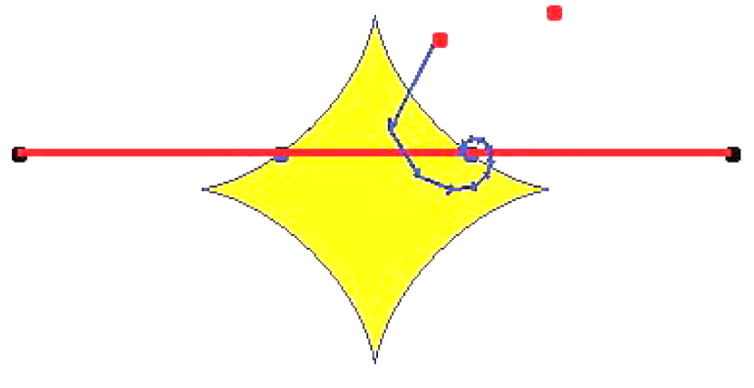
COMMENTS and OPEN QUESTIONS
As noted, the method parallelizes very well.
Work out rates in convex case?
Why does alternating projection (no reflection) work well
  for optical aberration but not phase reconstruction?
Show rigorously global convergence
  - in the appropriate basins?
Extend analysis to more general pairs of sets (and CAT (0) metrics)
  - even the half-line case is much more complex
  - as I may now demo.

Slide 20
REFERENCES
[1] Jonathan M. Borwein and Brailey Sims, “The Douglas-Rachford algorithm in the absence of convexity.” Chapter 6, pp. 93–109 in Fixed-Point Algorithms for Inverse Problems in Science and Engineering in Springer Optimization and Its Applications, vol. 49, 2011.
http://www.carma.newcastle.edu.au/~jb616/dr.pdf
[2] J. M. Borwein and J. Vanderwerff, Convex Functions: Constructions, Characterizations and Counterexamples. Encyclopedia of Mathematics and Applications, 109 Cambridge Univ Press, 2010.
    http://projects.cs.dal.ca/ddrive/ConvexFunctions/
[3] V. Elser, I. Rankenburg, and P. Thibault, “Searching with iterated maps,” Proc. National Academy of Sciences, 104 (2007), 418–423.
[4] J.M. Borwein and R.L. Luke, ``Duality and Convex
Programming," pp. 229–270 in Handbook of Mathematical Methods
in Imaging, O. Scherzer (Editor-in-Chief), Springer-Verlag. E-pub. 2010.

